Slide 1
Nemadji Energy Trail Center:
A Bad Deal for Superior
City of Superior Planning Commission
January 17, 2024
Brett Korte, Staff Attorney
Clean Wisconsin

Slide 2
About Clean Wisconsin
Founded in 1970
Our mission is to combat climate change and pollution in our air, water, and land, and ensure a healthy future for every Wisconsin community.
Over 30,000 members and supports across the state
Scientific, policy, and legal expertise informs our advocacy
v

Slide 3
Overview of the Nemadji Trail Energy Center
Proposed methane gas power plant
Up to 625 megawatts
To be built in Superior
  Along the Nemadji River
  Off 31st Ave. E
  Directly adjacent (SW) of the St. Francis Cemetery
Proposed by Dairyland, ALLETE, and Basin Electric
Anticipated to start operating in 2028

Slide 4
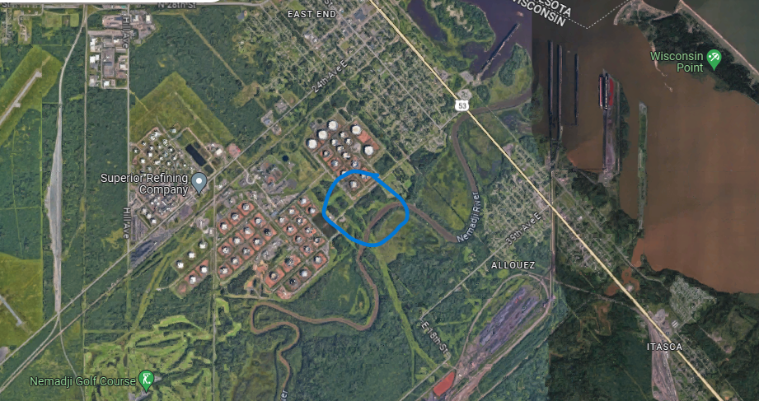
NTEC Proposed Location

Slide 5
Environmental Impacts: Local
Located on a steep, 46-foot slope leading to the Nemadji River
Heavy rains and highly erodible slop risk catastrophic failure leading to severe water quality impacts to river
Requires a large sheet pile retaining wall across 80% of the site, requiring 26,000 cubic yards of soil to be excavated for installation of, and another 80,000 cubic yards of backfill
Area prone to large, intense rainfalls—expected to continue in the future under current climate predictions.
Stormwater pond at the top of the slope

Slide 6
Environmental Impacts: Local
Neighbors exposed to safety hazards associated with truck traffic and construction, dust, and noise
Use of 31st Avenue E. as the access haul road, with an increase of 200-260 vehicles per day
After construction, increased air emissions, fog/ice/condensation, visual impacts, employee traffic, lights, possible stormwater changes
an increased safety hazard in a neighborhood that already suffered a major industrial accident at the Husky refinery

Slide 7
Environmental Impacts: Water
At least 4.36 acres of permanent wetland fill and 14.8 acres of temporary impact on the staging area that may last up to 3.5 years
Incorrect characterization of the wetlands leading to undervaluing the ecosystem services provided and the amount of mitigation required
Wetland impacts likely to reduce water retention ability
Many of the wetlands contain diverse native plants, and likely large numbers of rare plants species

Slide 8
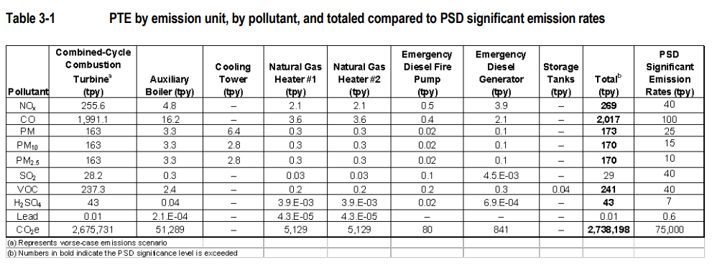
Environmental Impacts: Air

Slide 9
Environmental Impacts: Air
DNR found the total impact from NTEC plus background pollution would cause air pollution concentrations equaling:
  97.4 % of the ambient air standard for NOx (Nitrogen Oxides)
  80.9% of the ambient standard for PM2.5 (particulate matter)
Ozone cause headaches, coughing, dry throat, shortness of breath, a heavy feeling in chest, and fluid in the lungs
Chronic exposure can cause asthma
PM exposure can have cardiovascular effects (ardiac arrhythmias and heart attacks) and respiratory effects (asthma and bronchitis)
Risk compounds for at-risk individuals

Slide 10
Environmental Impacts: Climate
Would add over 2.7 million tons of CO_{2e} per year
  4% of Wisconsin’s total GHG emission (2021)
Projected lifespan of 40 years
109 million tons of CO_{2e} total
Not counting emissions from extracting methane, including leakage
Inconsistent with Gov. Evers’ 100% carbon-free electricity standard, national climate commitments, and limiting warming to 1.5° C by 2050

Slide 11
Regulatory Process
Public Service Commission of Wisconsin
Wisconsin Department of Natural Resources
  Wetland/waterway permits
  Air pollution permits
Local permits
Army Corps of Engineers Wetland permit
USDA Rural Utilities Service Loan

Slide 12
A Changing Landscape
Subsidizing gas inconsistent with current state and federal priority of transitioning to renewable energy
New opportunities through the federal Inflation Reduction Act
  tax credits
  $9.7 billion in funding for rural electric cooperatives to transition to renewable generation
New proposed EPA regulations that would require NTEC to achieve 30% hydrogen co-firing just 4 years after it begins operation.
Costs of renewables continue to drop
Availability of battery storage

Slide 13
Questions?

